Slide 1





KONGU ENGINEERING COLLEGE
PERUNDURAI ERODE-638060
DEPARTMENT OF COMPUTER APPLICATION
TITLE : PROFESSIONAL EXPENSE TRACKER
Using Python, Tkinter, and SQLite
TEAM MEMBERS:
SELVA J (24MCR095)
SURYA N (24MCR114)
VASHANTHA KUMAR KS (24MCR124)

Slide 2
Problem Statement
Manual Tracking : Individuals and small businesses face challenges due to budgeting mistakes and lost receipts.
Time-Consuming Process: Managing income and expenses manually takes significant time and effort.
Lack of Accuracy: Human errors lead to inaccurate records and poor financial insights.
Need for Automation: A user-friendly, automated system is essential for efficient financial tracking and better budgeting.

Slide 3
Introduction
Expense Tracker is a desktop-based expense tracking application.
Developed using Python (Tkinter) for GUI and SQLite for local database storage.
Helps users manage income, track expenses, and set monthly budgets.
Includes support for receipt uploads and a real-time financial summary.
Offers a user-friendly interface for efficient financial planning.
Demonstrates concepts like GUI development, database integration, and Python programming.

Slide 4
Scope of the Project
Designed for individuals and small businesses to manage finances efficiently.
Tracks income sources, expenses, and monthly budget limits.
Supports receipt upload and storage for future reference.
Offers a summary dashboard displaying total income, expenses, balance, and budget.
Built as a desktop GUI application using Tkinter for easy usability.
Uses SQLite database for lightweight, local data persistence.
Can be extended with features like data visualization, report generation, and user authentication.
Ideal for academic learning, personal finance management, and micro-entrepreneur usage.

Slide 5
Technologies Used
Python Core programming language used for application logic and development.
Tkinter Python's standard GUI library for building the user interface.
SQLite Lightweight relational database for local data storage and CRUD operations.
ttk (Themed Tkinter Widgets) Used to style the application with a more modern look (treeviews, buttons, tabs).
Datetime module For recording and managing dates of income and expense entries.
Filedialog module To support file upload functionality for storing expense receipts.
Messagebox module For user-friendly notifications and alerts within the GUI.

Slide 6
MODULE DESCRIPTION
Income Module
Allows users to enter income details (source, amount, date).
Stores data in the SQLite database.
Displays records in a Treeview table.
Expense Module
Records expenses with category, amount, date, and receipt upload.
Validates input and stores data securely.
Receipt file path is saved for reference.
Budget Module
Lets users set a monthly spending limit.
Stores the budget in the database. Used to calculate and display remaining balance.

Slide 7
Summary Module
Calculates and shows total income, total expenses, budget, and balance.
Updates dynamically as new entries are added.
Database Module
Handles database setup and CRUD operations using SQLite.
Ensures persistent data storage across sessions.
User Interface Module
Built using Tkinter and ttk for a clean, tabbed GUI.
Organizes functionality into Income, Expense, and Budget tabs.

Slide 8
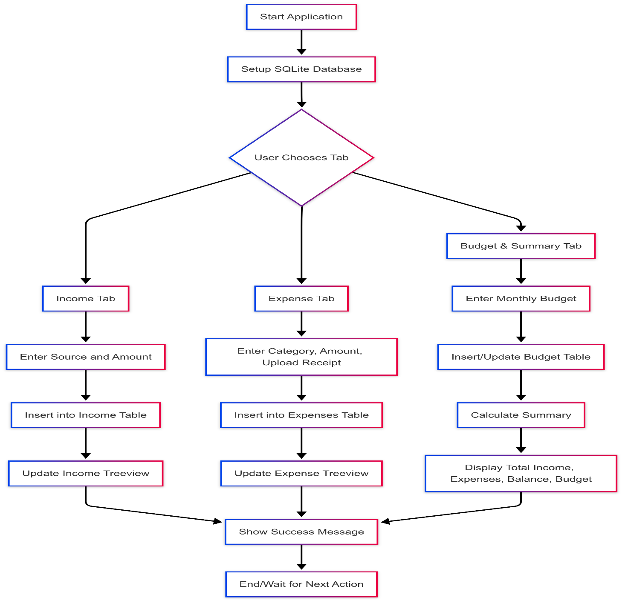
FLOW DIAGRAM

Slide 9
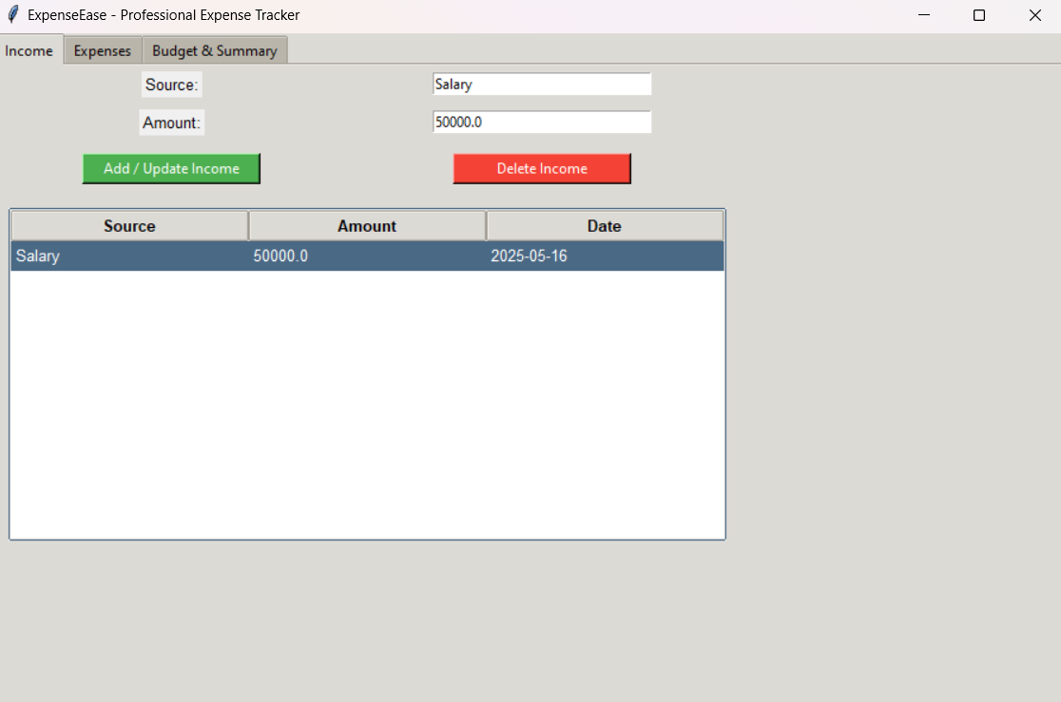
OUTPUT:

Slide 10
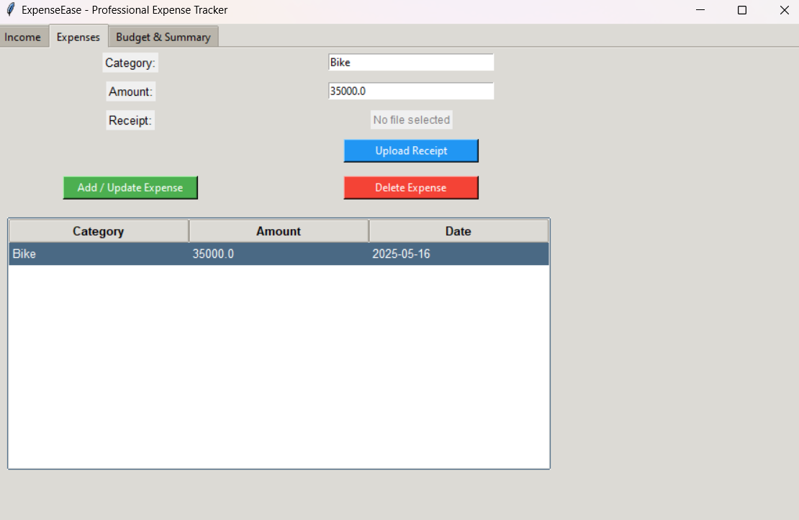

Slide 11
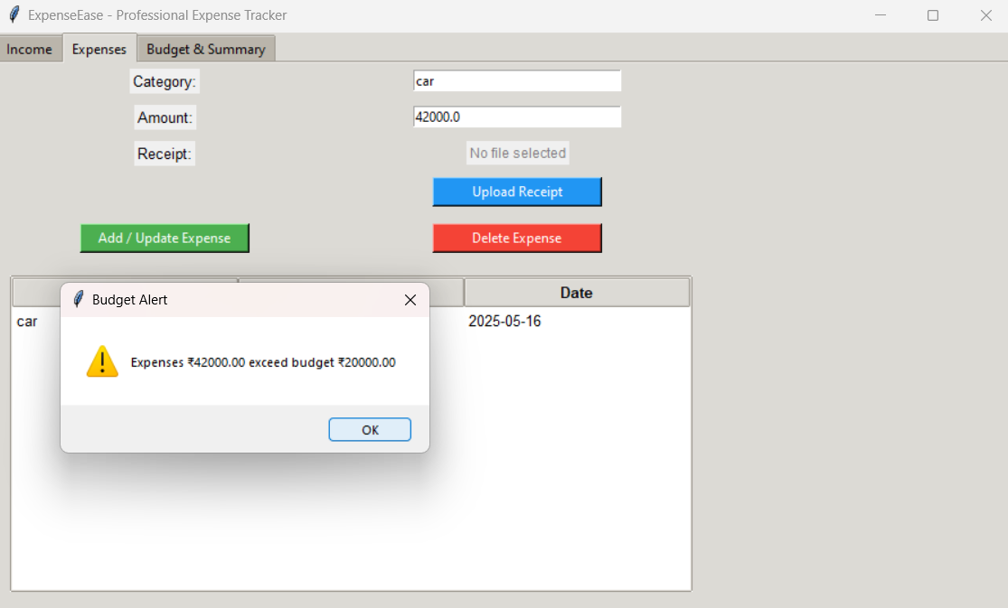

Slide 12
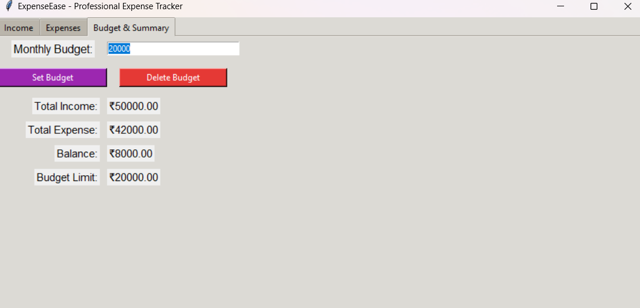

Slide 13
Conclusion
Expense Tracker provides a simple and effective solution for managing personal and small business finances. The application integrates a user-friendly graphical interface with a lightweight SQLite database to efficiently track income, expenses, and budgets. Features such as receipt uploads and a real-time financial summary help users stay organized and make informed decisions. This project demonstrates practical applications of Python programming, GUI development, and database management. Future improvements could include support for multiple users, report generation, and enhanced data visualization to further enhance usability and functionality.

Slide 14
THANK YOU

